Slide 1
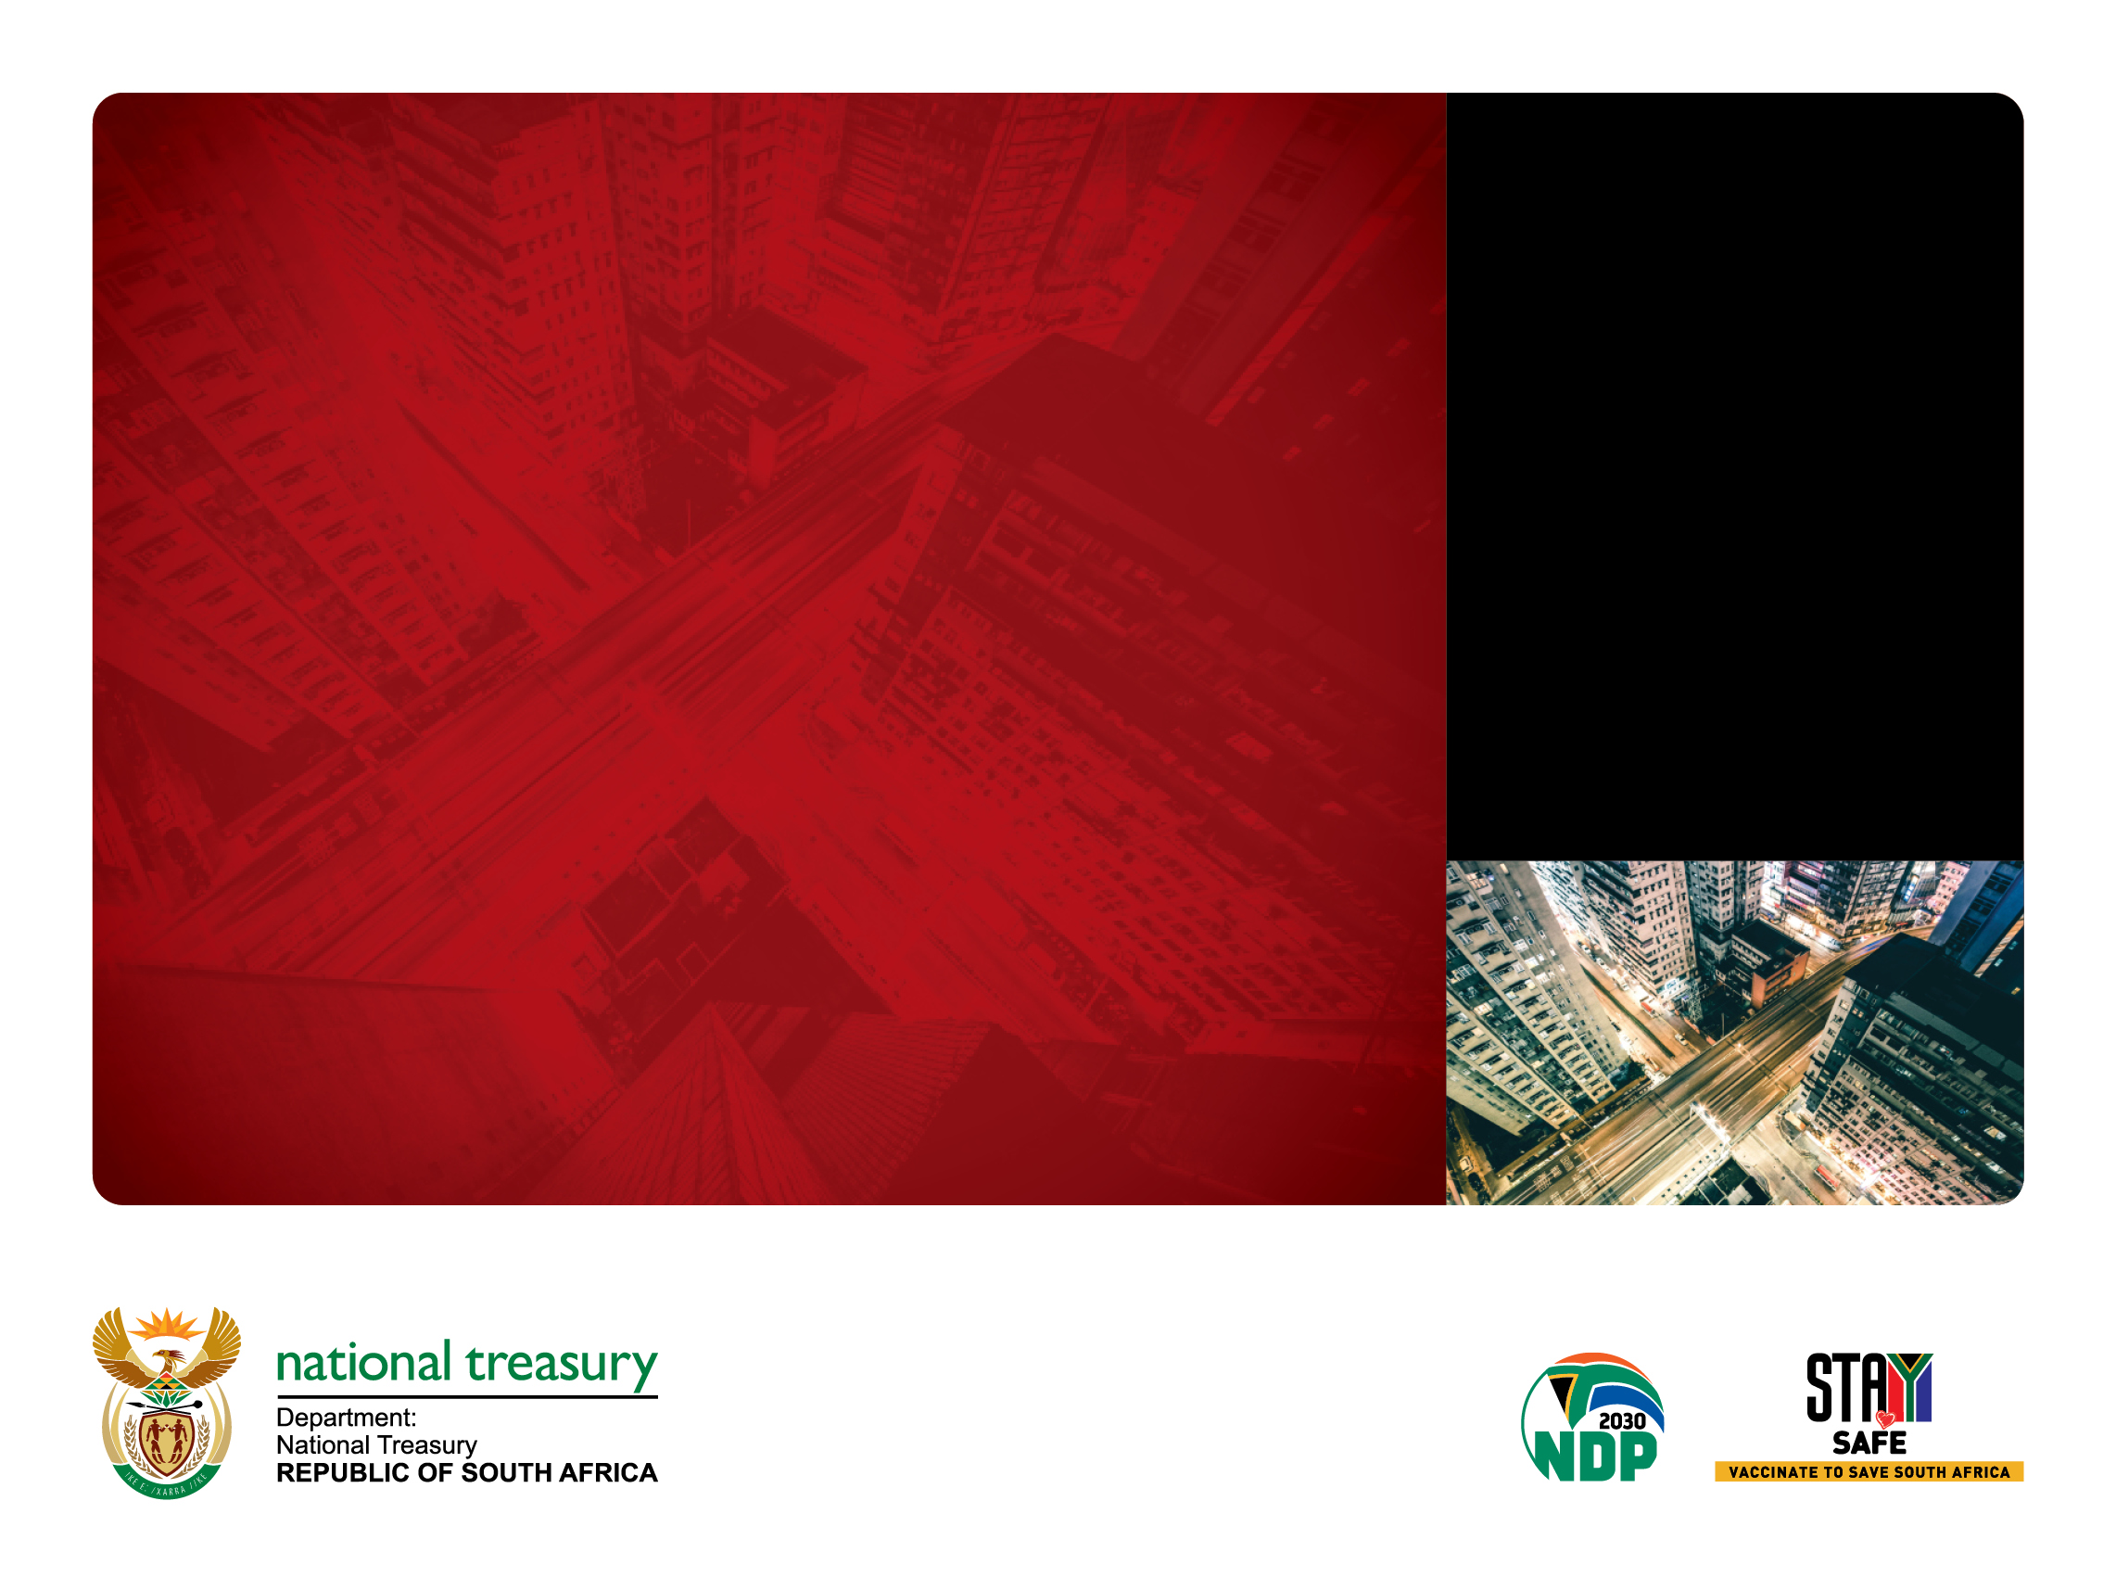
Budget update MTBPS
PRESENTED BY:
Mark Blecher
Vusi Maupa
18 November 2021
Presentation to the UNICEF, SPII

Slide 2
Overview
MTBPS tabled 11 November
The COVID-19 pandemic has magnified South Africa’s social and economic crises, further straining the public finances.
Over the next three years, government will balance support for economic recovery and reconstruction – through both short-term spending measures and structural reforms – along with rebuilding the public finances.
The economy has recovered more quickly than anticipated. Nevertheless, the recent spike in commodity prices, which has supported GDP growth and tax revenues, is considered temporary. Long-term structural constraints and scarring from the effects of the pandemic weigh on the outlook. Fiscal risks have increased.
Fiscal consolidation is critical to reduce the public debt burden, restore investor confidence and avoid overexposure to global and domestic risks.
Somewhat improved fiscal projections
No spending reductions proposed so far
Achieve primary surplus by 2024/25
The Medium Term Budget Policy Statement (MTBPS) proposes to maintain restraint in public expenditure. Government will not commit to new long-term spending in response to temporary revenue windfalls. No additional funding is provided to state-owned companies over the medium-term.

Slide 3
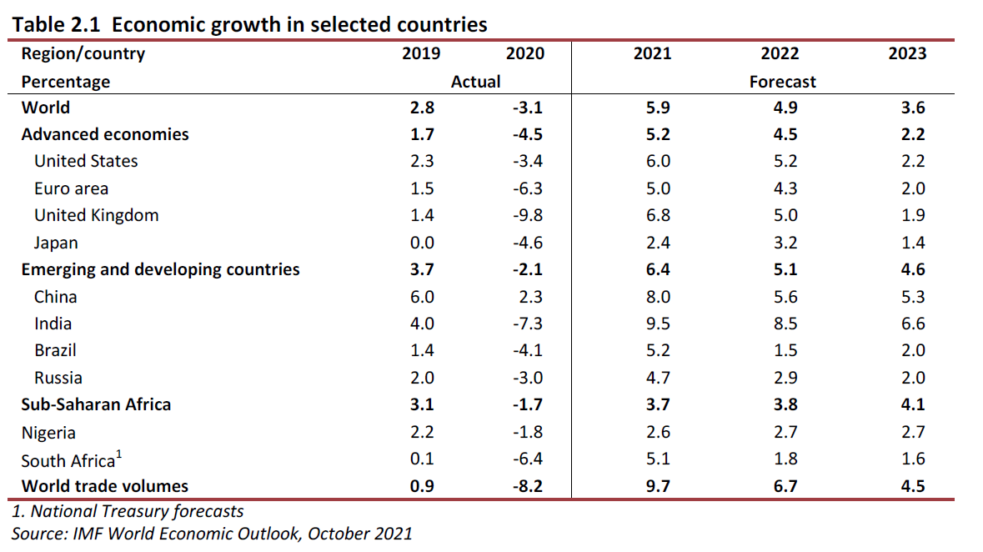
Global economic recovery still impacted by covid-19
The COVID-19 pandemic continues to take a toll on global growth. In developing economies, scarring – defined as medium-term economic performance below pre-pandemic projections – is expected to be pervasive.
Positive global growth outlook is predicated on several factors, including global vaccine access, sustained monetary and fiscal policy support, and stabilising inflation.

Slide 4
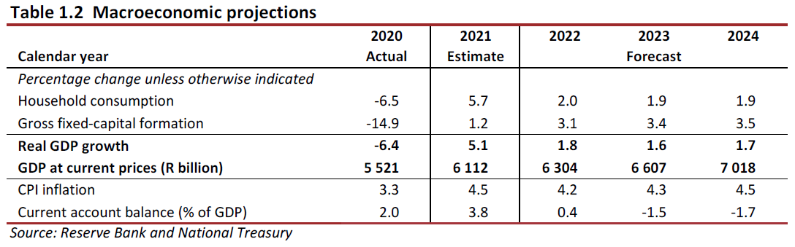
Domestic economic outlook
The South African economy grew faster than expected in the first half of 2021, but this momentum is expected to wane following public violence in July, port and rail disruptions, and the third wave of COVID-19 infections.
Real GDP is forecast to grow by 5.1 per cent in 2021. Output is expected to return to pre-pandemic levels in 2022, a year earlier than estimated in February. This is largely the result of global demand, higher commodity prices and the easing of COVID-19 lockdown restrictions.
Household consumption has improved but has not fully recovered from the pandemic. Inflation is contained within the target band, despite upward pressure from food and energy prices. Gross fixed-capital investment remains well below pre-pandemic levels. The labour market is weak, with unemployment at 34.4 per cent.

Slide 5
Fiscal strategy
Government remains committed to reducing the budget deficit and stabilising the debt-to-GDP ratio.
Government will use part of the higher tax revenues associated with the recent commodity price surge to narrow the deficit, and to provide short-term to the most vulnerable, and cover the higher costs of the public-service wage agreement.
In line with government’s commitment to support vulnerable households, particularly given the impact of COVID-19, additional resources for social protection will be considered, if the fiscal situation improves by February 2022.
Over the next three years, spending will remain restrained. To avoid a widening of the budget deficit, changes to spending will be funded through improved revenue performance or through reprioritisation and reviewing existing programmes.
Infrastructure projects will be financed through the Infrastructure Fund, using public-private partnerships and other funding arrangements to improve planning and speed up delivery.
Barring major new shocks or unbudgeted spending commitments, staying the course will lead to a primary fiscal surplus in 2024/25, bringing an end to fiscal consolidation at the end of the MTEF period.
This consolidation will be supported by structural reforms to unlock private-sector investment and job creation.

Slide 6
Fiscal framework
The consolidated deficit includes national and provincial government, social security funds and public entities.
The consolidated deficit will narrow from 7.8 per cent of GDP in 2021/22 to 4.9 per cent of GDP in 2024/25.

Slide 7
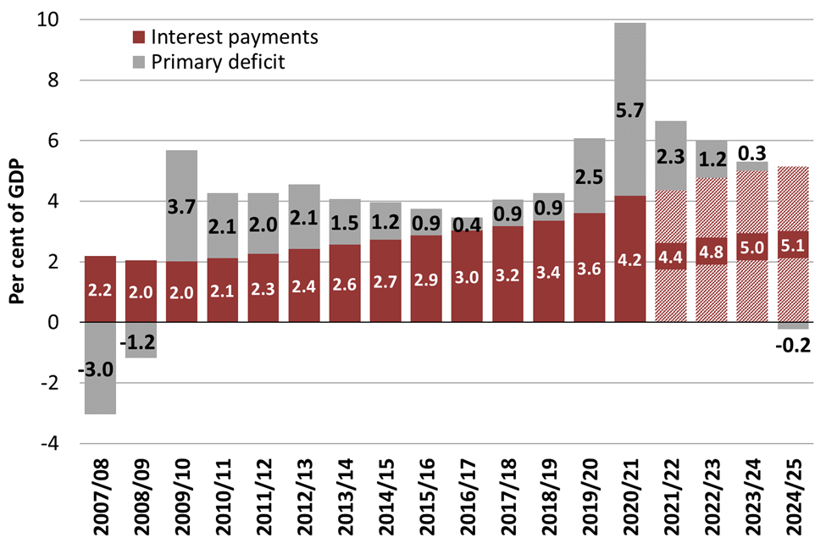
Main budget and primary balances
Main budget primary balance*
Main budget balance
*Excludes Eskom financial support and transactions in financial assets and liabilities
South Africa's fiscal position was already weak prior to the economic crisis in 2020
The COVID-19 pandemic led to a historic economic contraction, an unprecedented widening of the budget deficit and a spike in debt stock.
Interest payments now absorb a growing share of national resources, averaging nearly 5 per cent of GDP over the next two years.
Over the period ahead, government will continue to narrow the budget deficit, which is key to stabilising the debt-to-GDP ratio.
A primary budget surplus is projected by 2024/25.

Slide 8
Revenue outlook
Surging commodity prices have improved the in-year revenue outlook, yet these temporary benefits result in declining surpluses over the medium term.
Revised revenue projections fall short of pre-COVID-19 expectations by R284.7 billion until 2022/23.
Overall buoyancies beyond 2021/22 are lowered as the terms of trade momentum dissipates, and the outlook for several major tax bases declines relative to 2021 Budget estimates.
Further improvement in the tax-to-GDP ratio over the medium term depends on sustained economic growth and greater efficiency in revenue collection.

Slide 9
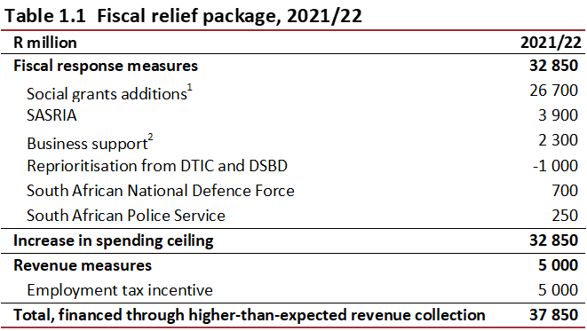
Fiscal response to COVID-19 and social needs
Higher-than-expected revenue collection enabled government to respond with a fiscal package of R37.9 billion in 2021/22.
The spending measures include reintroduction of the temporary R350 special COVID-19 social relief of distress grant until the end of 2021/22, with broadened eligibility to include caregivers who receive the child support grant.
An allocation of R3.9 billion for SASRIA – for balance sheet support to ensure that claims following the July public violence are settled. A further provisional allocation of R11 billion is provided for in the 2021/22 fiscal framework, should further support be required in the current year.
Support for small businesses affected by COVID-19 restrictions and the July public violence, amounting to R1.3 billion.
Additional funding totalling R950 million allocated to the South African Police Service and the South African National Defence Force.

Slide 10
Medium-term expenditure outlook
Considering the improved tax revenue estimates, government proposes to maintain some support to the economy over the MTEF period, including through a small increase in non-interest spending compared with the 2021 Budget projections.
Total main budget non-interest expenditure is projected to increase by R31.9 billion in 2022/23 and by R29.6 billion in 2023/24. Details of the spending allocations will be provided in the 2022 Budget. The following upward adjustments are included in the fiscal framework:
  An additional provisional allocation of R20.5 billion in 2022/23 for wage bill adjustments.
  Higher estimated spending by the National Skills Fund and sector education and training authorities of R1.4 billion in 2022/23 and R1.6 billion in 2023/24, reflecting the projected rise in skills development levy collections.
As a share of GDP, non-interest expenditure will moderate from 26.3 per cent in 2021/22 to 23.5 per cent by 2024/25, including a contingency reserve of R5 billion per year over the MTEF period.
Debt-service costs will continue rising over the medium term given the persistent main budget deficit, weaker currency and higher interest rates.
In line with government’s consolidation stance, main budget non-interest expenditure is projected to grow in line with consumer price index inflation in 2024/25.

Slide 11
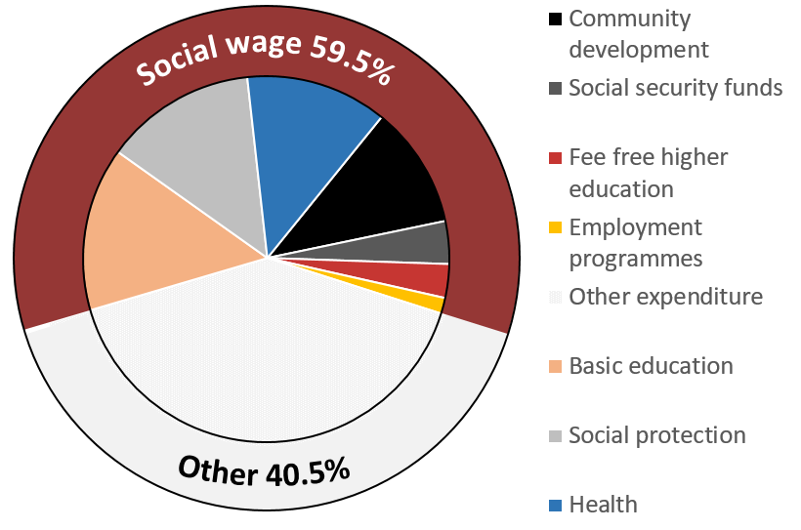
Social wage accounts for majority of non-interest spending
Per cent of consolidated non-interest spending, average over 2022 MTEF
The social wage accounts for nearly 60 per cent of consolidated non-interest spending over the MTEF period
Healthcare, education and social protection make up the bulk of this amount.

Slide 12
Considerations
Allocation decisions not yet taken at time of MTBPS – some of policy discussions less explicit
Great lockdown largest recession in century
Had major effects on GDP, revenue, debt and after significant increases in Budget 2020 led to large budget reductions in Budget 2021
Economy and revenue now coming closer to baseline (but below previous projections)
Interest payments have grown by R100b pa and >20% of revenue – crowding out spending
Many difficult budget decisions and dilemmas
  Recommendations of function groups currently exceed fiscal framework
  Many important and large budget pressures
  Continuing COVID-19 relief /stimulus vs restoring fiscal balances
Rebasing of GDP improve some of fiscal ratios

Slide 13
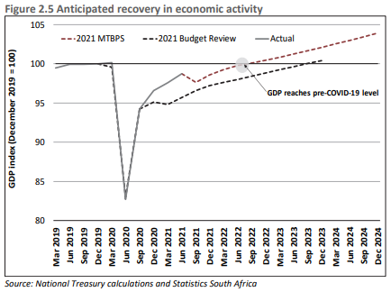
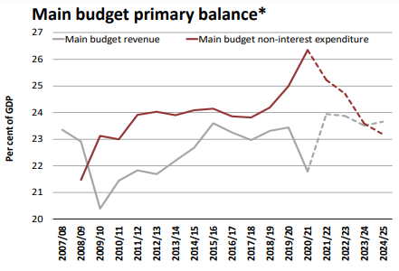
MTBPS – growth and fiscal balance
Economic recovery slightly better than projected in 2021 budget
Primary balance showing surplus from 2024/25 (NB excludes debt service costs)

Slide 14
Gap between revenue and expenditure and non-interest expenditure
Main budget deficit R380 billion in 22/23 and primary balance: -R77.2 billion

Slide 15
22/23 budget over three timeframes
Revenue reduced R127b, R63.8b recovery
Non-interest expenditure reduced R87b (plus R34.9b provisional), Implications for many sectors - to what extent can this be fixed?; R32b indicative (R15.1b unallocated)
Interest payments R303b now 2nd largest item in budget
Deficit still R380 bil (ie spending almost R400b more than revenue)

Slide 16
Provincial equitable share formula (PES) 22/23 over three timeframes
Budget 2021 had large reductions in PES, substantial pressures on provincial services; To what extent can this be fixed in Budget 2022?
Increases in MTBPS do not yet include future wage agreement

Slide 17
Division of revenue and unallocated amounts

Slide 18
Division of revenue share (%)
Interest crowding out expenditure
Shares change when exclude lower rows

Slide 19
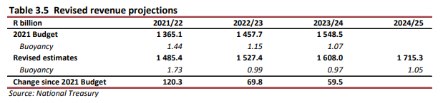
MTBPS - revenue
Revenue projections still lower than in 2020 Budget, e.g. R63 billion lower in 2022/23 and R69 billion lower in 2023/24

Slide 20
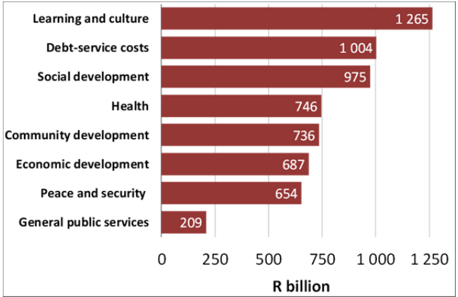
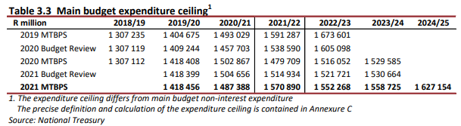
MTBPS - expenditure
Unallocated amounts across all functions R15.1bn, R28.8 and R29.3 bn
MinComBud still determining how to allocate these

Slide 21
Health pressures
COVID-19 vaccines (12-17 years, potential boosters, possible price increases)
COVID-19 future waves in 22/23 (e.g. R8b allocated 21/22 for 3rd wave)
Shortfalls for interns
Large budget reductions from budget 21/22
Shortfalls in goods and services esp non-negotiable areas
Retention of additional staff employed since 2020/21 for COVID-19
Wage freeze has/could contribute a lot to budget reductions, but uncertainty for 22/23 and MTEF

Slide 22
Social Development pressures
Shortfalls on social grants < CPI in years 2 and 3
Extended child support grant for double orphans
SRD R350 grant under discussion
Pressures from reductions in budget 2021 eg welfare services NGOs

Slide 23
Education pressures
Reductions to budgets in Budget 2021 esp PES puts pressure on provincial education departments including teacher numbers and class sizes
Decisions around NSFAS and higher education student funding have potential major cost implications for this budget
Shift of ECD function from Social Development to Education

Slide 24
Other large spending pressures
Presidential jobs programme – 500,000 job opportunities (is it possible to expand further?)
Wage agreement 2022 (some provision made for 22/23 year) and over MTEF
Free basic services
Eskom
Effects of Budget 2021 reductions on multiple sector eg Police

Slide 25
Presidential Employment programme
Existing EPWP and CWP programmes – how can be strengthened or improved?
PEP has opened several new steams e.g. 300,000 teacher assistants, social employment fund (IDC), pathway management
Budget likely to support for at least two years
How to strengthen active labour market programmes and make more coherent

Slide 26
2021/22 ADJUSTMENTS BUDGET (health)
Estimated total of R5.7 billion additional to provincial health, including:
  R14.7 billion to PES for wage agreement, health share estimated around R5.2 billion
  R243.2 million converted from NHI Indirect grant to HRTG for statutory posts
    R143.2 million already approved through Gazette by MoF in August (from personal services component)
    R100 million in adjustments budget (from revite component)
  R167.4 million for mental health and oncology services converted from NHI Indirect to respective components in the HIV, TB, Malaria and Community Outreach Grant

Slide 27
CHANGES TO CONDITIONAL GRANTS
– 2022 MTEF (Health)
Several proposals pertaining to conditional grants submitted by NDOH in August MTEF submission
After discussions at budget bilateral, function group meeting etc., proposals were approved, with some modifications:
  The HIV, TB, Malaria and Community Outreach Services Grant will be renamed the District Health Programmes Grant and have the following two components:
    The Comprehensive HIV/AIDS Component, to be created by merging the following components:
      HIV/AIDS
      TB
    The District Health Component, to be created by merging the following components:
      Community Outreach Services
      Malaria Elimination
      Human Papillomavirus Vaccine
      COVID-192
  Mental Health Services and Oncology Services components of the HIV, TB, Malaria and Community Outreach Grant will be moved to the direct NHI Grant. The NHIG will not have separate grant components for the programmatic areas funded therein.

Slide 28
CHANGES TO CONDITIONAL GRANTS
– 2022 MTEF (Health)
  The remaining mental health and oncology allocations within the NHI Indirect Grant (NHIIG) will be converted to the direct National Health Insurance Grant – R198.8 million per year
  R243.223 million per annum over the MTEF will be reprioritized towards the HRTG for interns and commserves. This includes:
      R115 million per annum from the Health Facility Revitalisation Grant
      R90 million per annum from the Non-personal services component of the NHIIG
      R43.2 million per annum from the personal services component of the NHIIG (R23.223 million from mental health services and R20 million from GP capitation contracting)
  All the above to be finalised in Cabinet approvals of the budget and will be communicated in allocation letter

Slide 29
HEALTH FUNCTION DISCUSSIONS
No further spending reductions proposed at this point
Health function group made recommendations for additional funding in the following areas:
  COVID-19 response – future waves
  COVID-19 vaccine rollout (augmenting both national and provincial allocations, to provide for possible boosters, new age groups etc.)
  Interns and CommServes
  Goods and services
However, decision on these still pending. Fiscal framework currently does not allow for all recommendations from all function groups.
MinComBud will re-convene after MTBPS to decide.

Slide 30
Conclusion
Government, through Operation Vulindlela, has made progress on several key reforms outlined in its October 2020 economic recovery plan.
Over the period ahead, government will continue to narrow the budget deficit to stabilise the debt-to-GDP ratio.
This consolidation will be supported by structural reforms that unlock private-sector investment and job creation.
The revenue windfall will partially support increased allocations for urgent social and economic priorities, increasing non-interest expenditure. Government will maintain such allocations should revenue performance improve over the medium term.
The fiscal outlook is highly uncertain.
Decisions around unallocated funds under discussion in MinCombud
Many difficult dilemmas and decisions to be taken – trade-offs not straight forward
Civil society views important and appreciate engagement

